Slide 1

Future of CSSI
Dr. Stefan Robila
Program Director
Office of Advanced Cyberinfrastructure (OAC)
Directorate for Computer & Information Science & Engineering (CISE)
National Science Foundation (NSF)
Feb 13, 2020 CSSI PI Meeting
Seattle WA

Slide 2
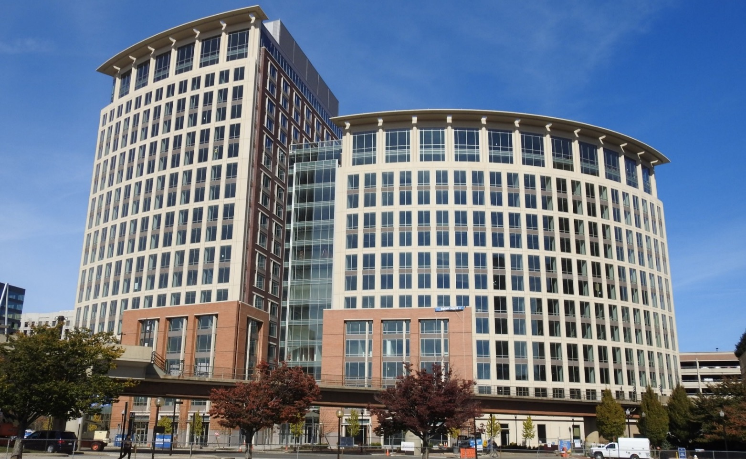
The National Science Foundation’s mission
“To promote the progress of science; to advance the national health, prosperity, and welfare; to secure the national defense...”

Slide 3

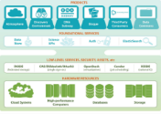
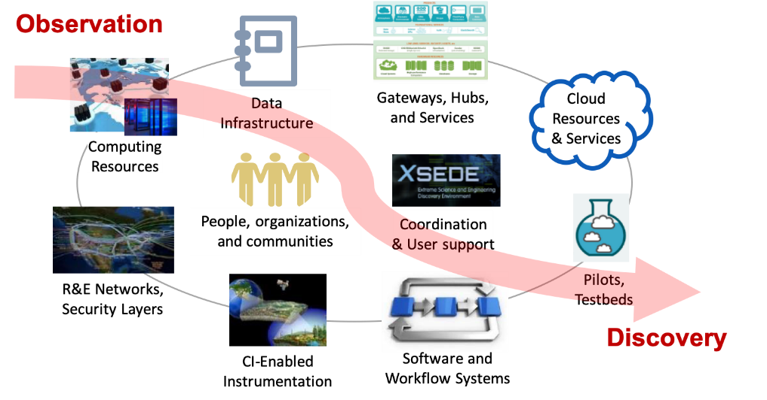




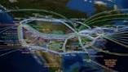

Office of Advanced Cyberinfrastructure (OAC)
People, organizations,
and communities
Coordination
& User support
Foster a cyberinfrastructure ecosystem to transform science and engineering research…
… through Research CI and CI research
Gateways, Hubs,
and Services
Data Infrastructure
Software and
Workflow Systems
CI-Enabled
Instrumentation
Pilots,
Testbeds
Cloud Resources & Services
Computing
Resources
R&E Networks,
Security Layers

Slide 4
Cyberinfrastructure for Sustained Scientific Innovation (CSSI)
NSF17-500
NSF17-526
NSF18-531, NSF19-548

Slide 5
Cyberinfrastructure for Sustained Scientific Innovation (CSSI)
Science-driven
Innovation
Close collaborations among stakeholders
Building on existing, recognized capabilities
Project plans, and system and process architecture
Clear deliverables
Measurable outcomes
Sustained and sustainable impacts
Awards (Elements / Frameworks)
Strong collaboration across all NSF S&E domains
Alignment with OAC and NSF investments
Responsive of new challenges / opportunities

Slide 6
CSSI Program Re-visioning – Stakeholder Input
Community Visioning Workshop
Oct 2019
NSF 20-015
Dec 2019
Emails, phone calls, meetings…
Other workshops and symposia
………
………
CSSI PI Meeting
Feb 2020
Community Survey
Jan 2020
Review Panels
NSF Programs Engagement

Slide 7
CSSI Program Re-visioning – Community Input
Community Visioning Workshop
Oct 2019
Diverse group of participants including domain and cyberinfrastructure experts from academia, industry, and national laboratories
Report summarizing the information exchanged during the workshop including feedback on the CSSI program and best practices in developing sustainable scientific CI.
NSF 20-015
Dec 2019
RFI on Data-Focused CI Needed to Support Future Data-Intensive S&E Research
Seek broad community input on data-intensive scientific questions and challenges and associated needs specifically related to data-focused cyberinfrastructure. Emphasis on “cross-disciplinary and domain-agnostic solutions”
Responses publicly posted. A summary report identifying new directions for data intensive CI.
Community Survey
Jan 2020
NSF Award #1930025 (Nexight)
A survey was developed to query the broader CI community on the impact of program.
Report on survey results providing new understanding of the program's impact, and the most effective methods of research support of CI.
CSSI PI Meeting
Feb 2020
Brings together for the first time DIBBS, SI², and CSSI PIs in common meeting to share best practices, identify challenges and opportunities for building research CI.
Meeting report and direct interaction with the PI community

Slide 8
Talk to us!
Alan Sussman Amy Walton Daryl Hess
Joseph Whitmeyer Stefan Robila Vipin Chaudhary
CSSIQueries@nsf.gov

Slide 9
Thank You!
Stefan Robila srobila@nsf.gov

